Slide 1


Methods
Topic 7

Slide 2

Objectives
To learn about method
To know the method definition and method call
To know the method execution flow
To learn about local variables & global variables.

Slide 3

Introduction
A method (module) is a group of statements that exists within a program for the purpose of performing a specific task.
Most programs are large enough to be broken down into several subtasks.
Each method is assigned to perform a specific subtask.
Divide and conquer: It’s easier to tackle smaller tasks individually.

Slide 4
Introduction
Using methods, your program/code is modularized.
Benefits of code modularity:
Simpler code
Program that contains several small methods easier to read than one long sequence of statements in the main method.
Code reuse
Can call a method many times whenever it is needed in any part of a program (avoiding code redundancy)
Easier code management & testing
Can test each method separately and thus easier to isolate and fix errors
Easier facilitation of teamwork
Share the workload, different programmers can be assigned the job of writing different methods.

Slide 5
What is Method???
public class Hello { public static void main (String [] args) { System.out.println("Test");
System.out.println("I like JAVA"); System.out.println("JAVA is very interesting");
}//main
public class Hello { public static void main (String [] args) { System.out.println("Test");
display(); }//main public static void display() { System.out.println("I like JAVA"); System.out.println("It is interesting"); } }//class

Slide 6
What is Method???
public class Rectangle { public static void main (String [] args) {
int width = 10, height = 30;
int area = width * height;
System.out.println("Area is" +area);
}//main
public class Rectangle { public static void main (String [] args) {
int width = 10, height = 30;
calculateArea(width, height); }//main public static void calculateArea(int width,int height) { int area = width * height;
System.out.println("Area is" +area);
} }//class

Slide 7
Method Definition
To create a method you write its definition.
The complete codes (consisting of method header & body) for a method is known as a method definition.

Slide 8
Method Call
To execute the method that has been defined, you write a statement that calls it.
The statement that contains a method’s name to call the method is known as method call.
When a method is called, the statements in the method’s body are executed (execution jumps to method’s body).
Then, execution jumps back (returns) to the part of the program that called the method, and resumes execution at that point.

Slide 9
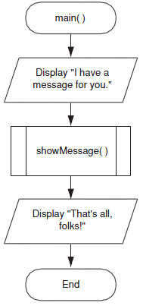
Defining and Calling a Method
When flowcharting a program with methods, a method call is shown with a rectangle that has vertical bars at each side
Example:
Call of method showMessage():

Slide 10
Defining and Calling a Method
Definition of a method is done in a separate flowchart.
The starting terminal symbol usually shows the name of the method.
The ending terminal symbol for all methods shows ‘Return’ because it marks the point where the computer returns to the part of the program that called the method.

Slide 11
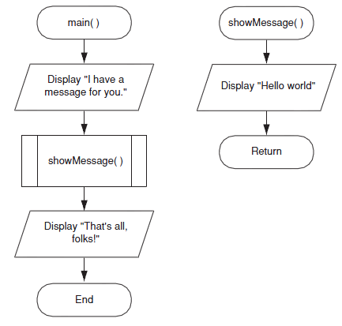
Defining and Calling a Method
Definition of method showMessage():

Slide 12
Method Definition
Method definition always contains two parts:
A header
The starting point of the method.
A body
Contain all statements to perform the method’s task.

Slide 13
Method Definition
A complete method definition:
public static void showMessage()// Method Header
{ // Start of method body
System.out.println("Hello World. ");
} // End of method body

Slide 14
Types of Method
Methods can return zero or one value
Void methods
Methods that do not have a return type
Value-returning methods
Methods that have a return type
Notes:
Ada 2 kategori method
1.Method yg dpt pulangkan nilai-→guna return
2.Void method→tak dpt pulangkan nilai

Slide 15
Method Header
A method definition begins with a method header.
The Syntax:
modifier ReturnType MethodName (Formal ParameterList )
public static void main (String args[ ] )
public static void showMessage ( )
public static double deposit (double money)
public static double price (int quantity)
Void methods
Value-returning
methods

Slide 16
Method Header: Example
public static void showMessage ( )
Modifiers
(public static
if
no object)
return
type
(void if no return type)
method
name
Formal parameter list(blank if no parameter)
The parameter list specifies the type
and name of each parameter
The name of a parameter in the method
declaration is called a formal parameter

Slide 17
Method Body
The method header is followed by the method body.
public static void showMessage()
{
String name = "Ali";
System.out.println("Hello, "+ name);
}
name is local data
Local data are created each time the method is called, and are destroyed when it finishes executing

Slide 18
Method Call in Java
Syntax to call a method:
ClassName.methodName(actual parameter list);
Example:
Hello2.showMessage( );
Math.pow(2, 5);
Note: ClassName is optional if method is called in the same
class where it is defined
e.g. showMessage( );

Slide 19
Method Call in Java
A method call will invoke the method.
In class Hello2, showMessage() is called with statement:
showMessage ( );
method
name
Actual parameter list(blank if no parameter)
In class other than Hello2, showMessage() is called with statement:
Hello2.showMessage ( );

Slide 20
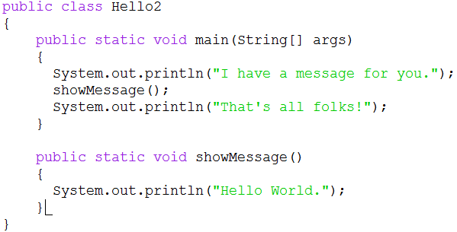
Defining and Calling a Method in Java
A complete program (from previous flowchart):

Slide 21
Method Execution Flow
If the called method is in the same class, only the method name is needed
Hello2
main()
showMessage()
showMessage();

Slide 22
Method Execution Flow
The called method is defined in another class
Class1
Class2
main()
doIt()
helpMe()
Class2.doIt();
helpMe();

Slide 23

What are method names here? Which one is method header and method body? Which line shows method call? What is the output of this code?
1 public class Hello 2 { 3 public static void main (String [] args) 4 { 5 display();
6 System.out.println("I will try to get A"); 7 }//main 8 public static void display() 9 { 10 System.out.println("I like JAVA"); 11 System.out.println("It is interesting"); 12 } 13}//class

Slide 24
Local Variables
A local variable is declared inside a method and cannot be accessed by statements that are outside the method.
Scope describes the part of the program in which a variable can be accessed.
Variables with the same scope must have different names.

Slide 25
Global Variables
A global variable is accessible to all methods within a class.
It can be used for variables that will be used by all methods in a class.

Slide 26
Global Variables
Have to use public static for declaration, e.g:
public static int number;
The declaration of global variable is placed inside class, but outside methods, e.g:
public class CalculateMin {
public static Scanner scan = new Scanner (System.in);
public static String name;
public static void main (String [] args)
{...
...
}

Slide 27
Exercise 1
Write definition of a void method named printInfo(). In the method, display today’s day and date.
Write definition of a void method named determineAchievement(). In this method, read an input from user, which is mark. If the mark is more or equal to 50, display “You passed”, otherwise display “You failed”.
Write definition of a void method named determineSugarLevel(). In this method, read an input from user, which is sugarLevel. If the sugarLevel is between 4.0 – 5.4, display “Normal”, else if the sugarLevel is lower than 4.0, display “Low”, otherwise, display “High”.

Slide 28
Exercise 2
Create a program which consists of main method and calculateMarks() method.
Write method definition for the calculateMarks() method. This method will calculate the total marks by summing up the carry marks and final exam marks. Declare and initialize carry marks with 56 and final exam marks with 90 as local variables. At the end, the total marks will be displayed.
In the main method, ask student’s name and matric number, then call method calculateMarks() Then, your program should print “End”.

